Slide 1
Boat Potatoes
Matthew 14:28-33
Notes:
\\DELLIE\New folder\Church stuff (master)\ESBC\Projectors\BenQ\Benq MX662 Benq MX662 (FCBC latest) 3500 lumens
Native XGA Resolution (1024x768)
Native 4:3 (5 aspect ratio selectable)

Slide 2


Slide 3

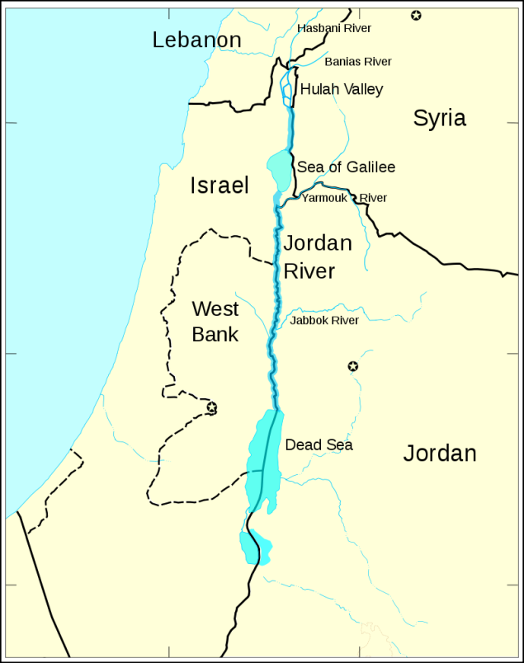
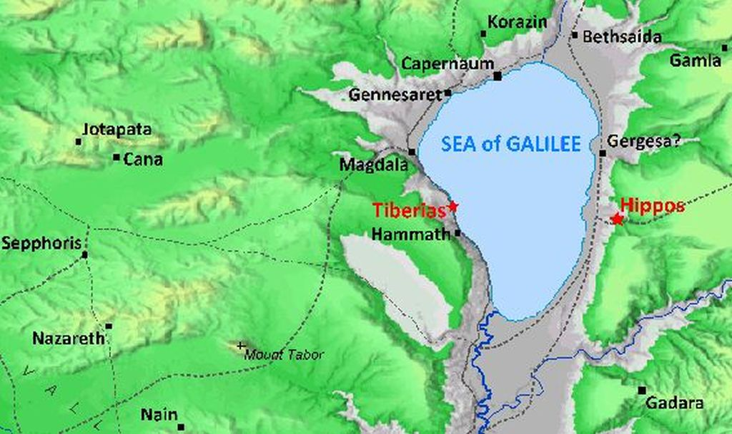
Sea of Galilee at Ginosar (Gennasaret)

Slide 4
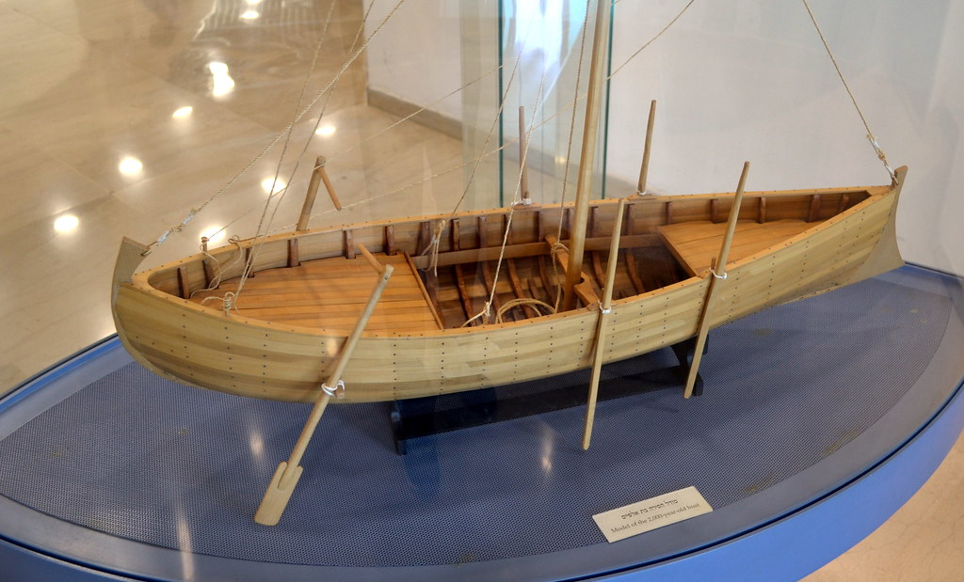

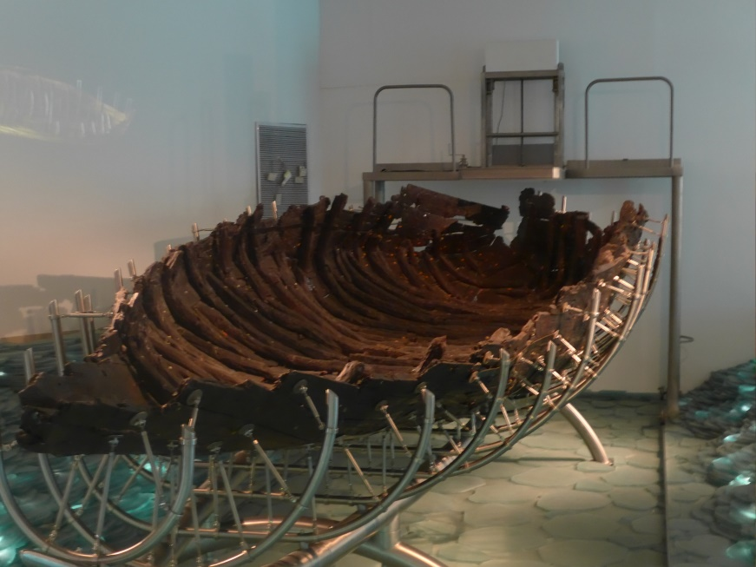
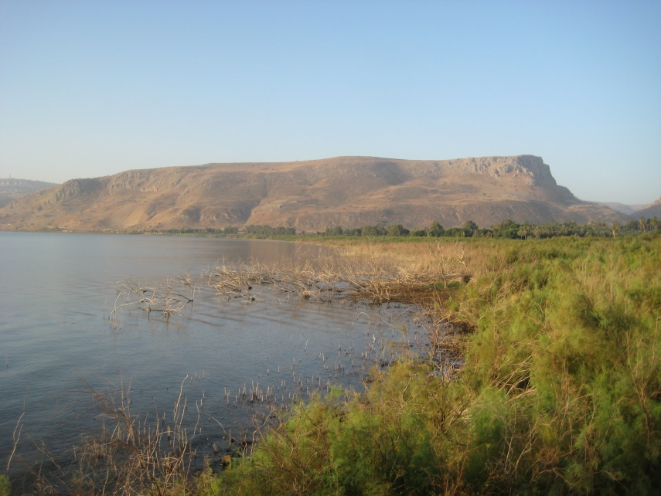
Boat Reconstruction
The Galilean hills in twilight
The Jesus Boat
Galilean hills

Slide 5
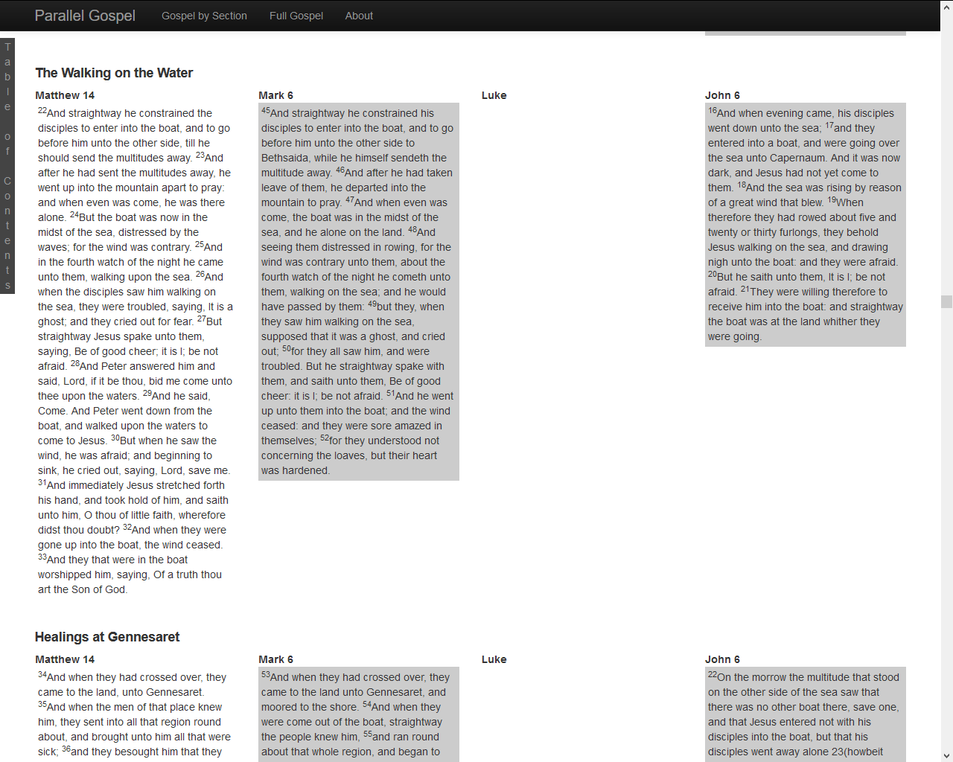
The Synoptic Gospels presented side-by-side
www.para-gospel.com/full

Slide 6
Video of storm
www.youtube.com/watch?v=SIW6HVl4qSE

Slide 7


Slide 8
Matthew 14:27
²⁷ But immediately Jesus spoke to them and said, ‘Take heart, I AM; do not be afraid.’
²⁷ εὐθὺς δὲ ἐλάλησεν αὐτοῖς ὁ Ἰησοῦς λέγων· Θαρσεῖτε, ἐγώ εἰμι· μὴ φοβεῖσθε.
Immediately now spoke Jesus to them saying Take courage I it is not fear
www.biblehub.com/interlinear/matthew/14-27.htm
John 18
Jesus asked the crowd approaching him, “Who are you looking for?” They said, ‘Jesus of Nazareth.’ Jesus replied, ‘I am he.’ Judas, who betrayed him, was standing with them. When Jesus said to them, ‘I am he’, they stepped back and fell to the ground.
Euthys Εὐθὺς Immediately | de δὲ now | elalēsen ἐλάλησεν spoke | ho «ὁ - | Iēsous Ἰησοῦς» ⇔ Jesus | autois αὐτοῖς , to them | legōn λέγων , saying | Tharseite Θαρσεῖτε ! Take courage | egō ἐγώ I | eimi εἰμι , it is | mē μὴ not | phobeisthe φοβεῖσθε . fear

Slide 9

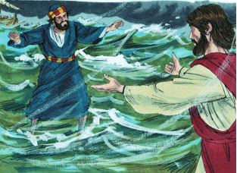
This gift is so valuable it can’t be risked, or
This gift is so valuable it must be risked.

Slide 10
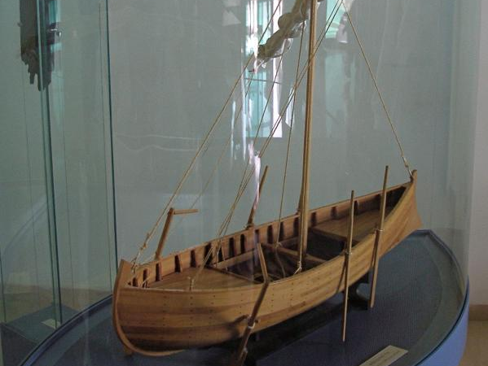
What is the greatest gift God has given to you—what’s in your boat? Are you a potato?
Have you buried your treasure (e.g. because of comparison, fear and sloth)?
What might tempt you to stay in the boat?
Imagine you and God are reviewing your life together: how could you take steps to minimise the regret factor at the end of your life?

Slide 11
American Dream
“The American Dream is the belief that anyone, regardless of where they were born or what class they were born into, can attain their own version of success in a society where upward mobility is possible for everyone. The American Dream is achieved through sacrifice, risk-taking and hard work, not by chance.”
Apparently invented in 1931 by historian James Truslow Adams
How to Live the American Dream
Work hard.
Work smart. ...
Get an education. ...
Be enterprising. ...
Be thrifty. ...
Devote yourself to your passions. ...
Buy property.
www.wikihow.com/Live-the-American-Dream

Slide 12
Summary
You need to be in the boat—walking with God, listening and obeying
There will be storms, but don’t be afraid: we follow one who walks on storms
Jesus is always at hand, even if he isn’t in the boat
When faith falls short, he will lift us up
Growth comes during the storm (or desert, or the dark night of the soul)
Know your gifts, and take risks with them
Beware modern myths and idolatries

