Slide 1

Firm Foundations

Slide 2
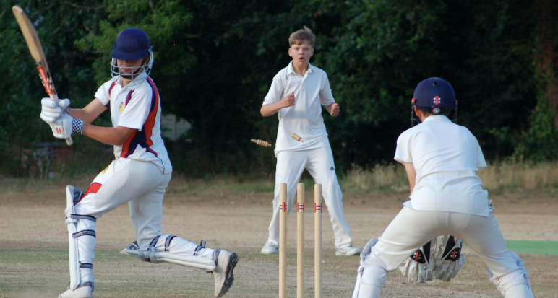
Firm Foundations

Slide 3


Slide 4
Firm Foundations
A People of Word and Spirit

Slide 5

Love His Word
Tim 3:16: ‘all scripture is God breathed and useful for teaching, rebuking, correcting and training in righteousness’.
Ps 12:6: “The words of the LORD are pure words, like silver refined in a furnace on the ground, purified seven times.”

Slide 6
Filled with His Spirit
Acts 1:8
But you will receive power when the Holy Spirit has come upon you, and you will be my witnesses.
You – its personal
Will – its definite
Receive – a gift
Power – ‘the ability or capacity to do something’
Witnesses – purpose

Slide 7


Gordon Fee – Paul, The Spirit and the People of God
If the church is to be effective in our post-modern world, we need to stop paying mere lip service to the Spirit and to recapture Paul’s perspective: the Spirit as the experienced, empowering return of Gods own personal presence in and among us, who enables us to live as a radically eschatological people in the present world while we await the consumption. All the rest, including fruit and gifts (that is ethical life and charismatic utterances in worship), serve to that end.

Slide 8
Attributes of the Holy Spirit
Omnipresent (all present) - Ps 139:7
Omnipotent (all powerful) - Luke 1:35
Omniscient (all knowing) - I Cor 2:9-10
Eternal - Heb 9:14
Truth - 1 Jn 5:6
Holy – Luke 11:13
The Spirit of Truth - Jn 16:13
The Spirit of Love - Romans 15:30
The Spirit of Holiness - Rom 1:4

Slide 9
The work of the Holy Spirit:
Creation - Gen 1:2
Sustaining life - Ps 104:29/30
Resurrection - Rom 8:11
Regeneration - Titus 3:5/6

Slide 10
Images of the Holy Spirit:
Wind (John 3:8) – suggesting how he moves in the hearts of people bringing faith and life.
Water (Jn 7:37/39) – communicating how the Spirit can fulfill the deepest longings of the heart, quenching spiritual thirst
Fire (Acts 2:3) – the holy presence of God – consuming what is wrong

Slide 11
Images of the Holy Spirit:
Dew (Ps 133:1/3) – gently refreshing
Oil (Ps 23:5) – associated with consecration and the supernatural anointing of the spirit
Dove (Math 3:16) – descending out of heaven as a dove
Clothing (Acts 1:8) – picture of the gift of the Spirit’s power clothing us / enabling us to live a life consistent with the gospel

Slide 12
The spirit ruach of Yahweh is God’s power in action – the wind/breath of God.

Slide 13
David Watson – One on the Spirit
A good test for any claims for a new work of the Spirit is this:
Is Christ glorified? Is Christ at the centre? If Christians claim some blessing of the Spirit, have they a new love for Jesus, a new hunger for his word, a new desire to tell others about him? These are the critical issues; and personal experiences without these Christ-centred consequences are either meaningless or counterfeit'.

Slide 14
John 7:37/38:
“If anyone thirsts, let him a come to me and drink. Whoever believes in me, as the Scripture has said, ‘Out of his heart will flow rivers of living water.’” Now this he said about the Spirit, whom those who believed in him were to receive,”

Slide 15
Firm Foundations
A People of Word and Spirit

